Slide 1
Constraint Satisfaction, Part 1 Lecture 11 Chapter 6, Sections 6.1-6.3
Jim Rehg
College of Computing
Georgia Tech
February 8, 2016

Slide 2
Administrative Updates
Project 1 is due Sunday Feb 14 at midnight
The submission site closes at 1am on Feb 15
Be sure to upload your solutions before the site closes
You have a one hour grace period in case of network issues etc.
No late submissions will be accepted
Midterm exam will be held in-class on Monday Feb 29
Exercises on combinatorial search (Chapter 3) released today
These will not be graded, but we will release solutions

Slide 3
Search So Far
Classical (combinatorial) search:
State space has no explicitly represented structure
Implicit structure in generating successors and testing for goals
Heuristics encode problem-specific information to guide search
Constraint Satisfaction
Type of search problem, goal is to assign values to variables
Structure of state space and goal test can be exploited
Develop general-purpose reusable solution methods

Slide 4






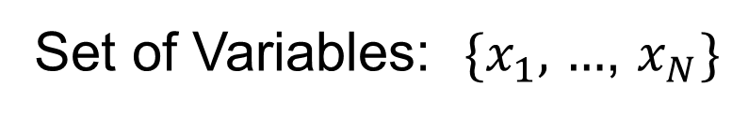

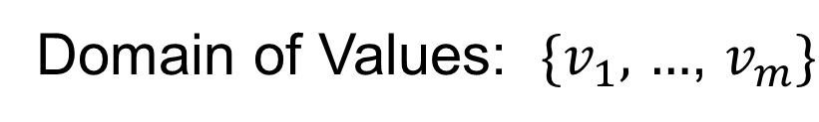

Constraint Satisfaction Problem: Definition
State Representation
Goal Test
Constraints specify allowed assignments
Example of formal representation language
Enables useful general purpose methods
$$x_{1}$$
$$v_{1}$$
Set of Variables: $\{x_{1},$ $…$, $x_{N}\}$
Domain of Values: $\{v_{1},$ $…$, $v_{m}\}$
$$x_{2}$$
$$v_{2}$$
$$⋮$$
$$⋮$$
$$x_{N}$$
$$v_{m}$$
Notes:
Whereas the state model in our previous lectures was a black box, CSP’s use a representation language to describe the search problem. This permits general-purpose solution methods that work for broad classes of problems.

Slide 5
Constraint Satisfaction Problem: Definition
State Representation
Goal Test
Constraints specify allowed assignments
Example: ALL-DIFF
Each variable is assigned a value
No value is assigned more than once
$$x_{1}$$
$$v_{1}$$
Set of Variables: $\{x_{1},$ $…$, $x_{N}\}$
Domain of Values: $\{v_{1},$ $…$, $v_{m}\}$
$$x_{2}$$
$$v_{2}$$
$$⋮$$
$$⋮$$
$$x_{N}$$
$$v_{m}$$

Slide 6
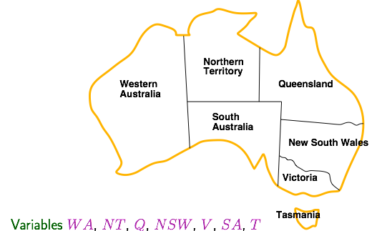
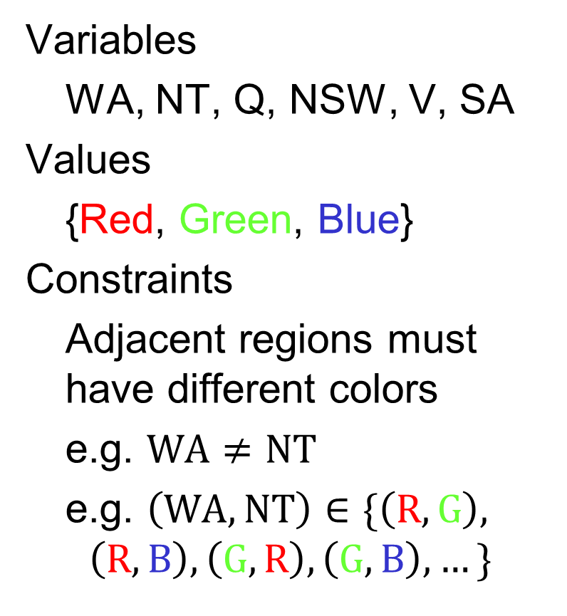
Example: Map Coloring
Variables
WA, NT, Q, NSW, V, SA
Values
{Red, Green, Blue}
Constraints
Adjacent regions must have different colors
e.g. $WA≠NT$
e.g. $\left(WA,NT\right)∈\{\left(R,G\right),$ $$\left(R,B\right),\left(G,R\right),\left(G,B\right),…\}$$

Slide 7
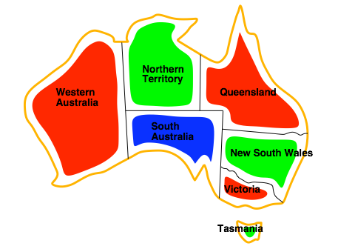
Map Coloring Solution

Slide 8
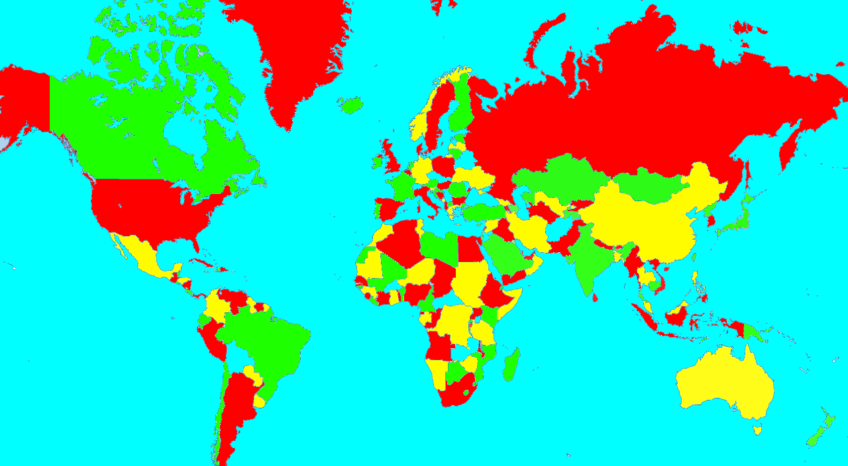
4 Color Theorem
Only four colors are needed to color a planar map
Notes:
This is just an side comment, not part of the core material for this class.

Slide 9
Constraint Graph Representation
NT
Q
WA
NSW
SA
Nodes are variables
Arcs connect constrained variables
Binary CSP – Each constraint relates only two variables
In this example, inequality constraints
V
T

Slide 10




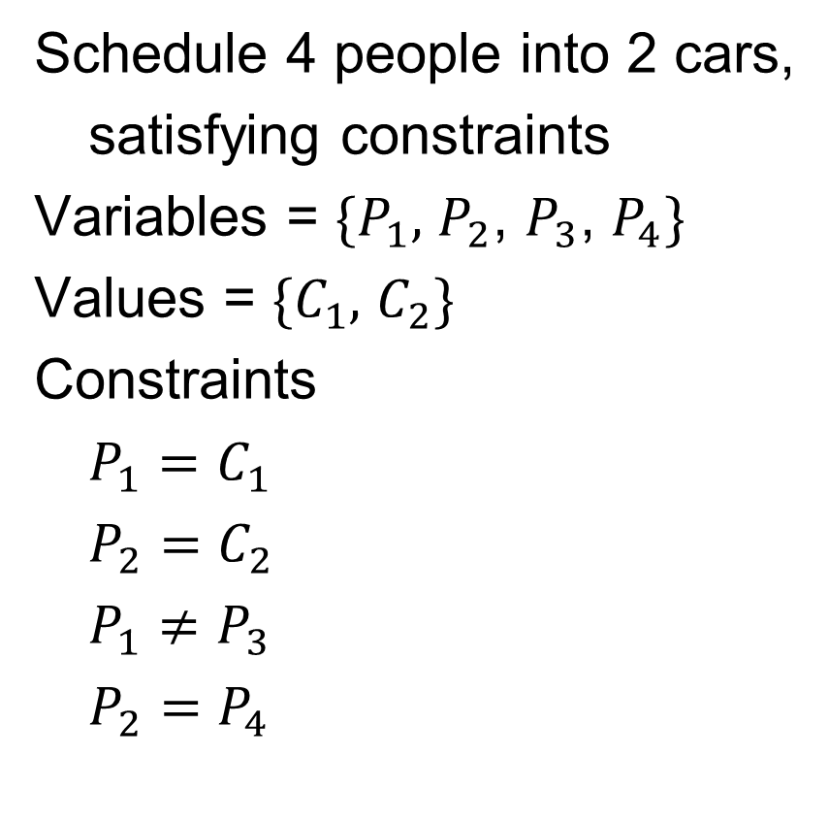






Example: Car Pool Scheduling
Schedule 4 people into 2 cars,
satisfying constraints
Variables = $\{P_{1},$ $P_{2}$, $P_{3}$, $P_{4}\}$
Values = $\{C_{1},$ $C_{2}\}$
Constraints
$P_{1}=C_{1}$
$P_{2}=C_{2}$
$P_{1}≠P_{3}$
$P_{2}=P_{4}$
$$P_{1}$$
$$\{C_{1}\}$$
$$P_{2}$$
$$\{C_{2}\}$$
$$≠$$
$$=$$
$$P_{3}$$
$$\{C_{1},C_{2}\}$$
$$P_{4}$$
$$\{C_{1},C_{2}\}$$
Possible Solution: $P_{1}=C_{1}$, $P_{2}=C_{2}$, $P_{3}=C_{2}$, $P_{4}=C_{2}$

Slide 11




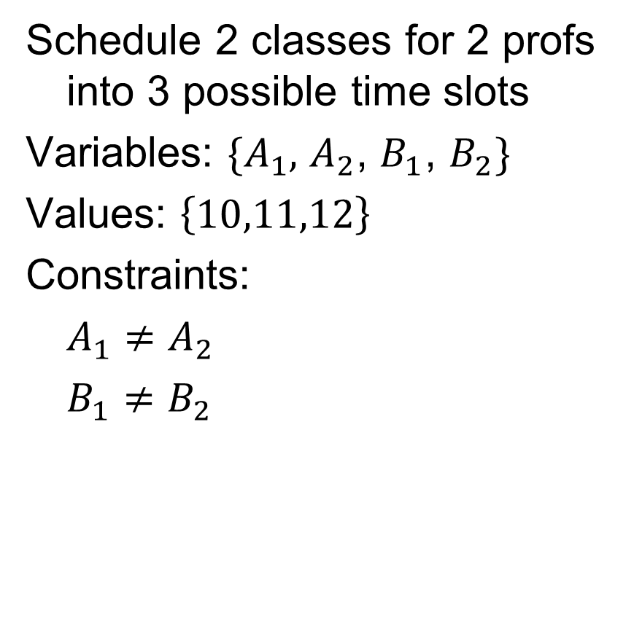





Example: Class Scheduling
Schedule 2 classes for 2 profs into 3 possible time slots
Variables: $\{A_{1},$ $A_{2}$, $B_{1}$, $B_{2}\}$
Values: $\left\{10,11,12\right\}$
Constraints:
$A_{1}≠A_{2}$
$B_{1}≠B_{2}$
$$A_{1}$$
$$\{10,11,12\}$$
$$B_{1}$$
$$\{10,11,12\}$$
$$≠$$
$$≠$$
$$A_{2}$$
$$\{10,11,12\}$$
$$B_{2}$$
$$\{10,11,12\}$$
Possible Solution: $A_{1}=10$, $A_{2}=11$, $B_{1}=11$, $B_{2}=12$

Slide 12
Example: Class Scheduling
Schedule 2 classes for 2 profs into 3 possible time slots
Variables: $\{A_{1},$ $A_{2}$, $B_{1}$, $B_{2}\}$
Values: $\left\{10,11,12\right\}$
Constraints:
$A_{1}≠A_{2}$
$B_{1}≠B_{2}$
$$A_{1}$$
$$\{10,11,12\}$$
$$B_{1}$$
$$\{10,11,12\}$$
$$≠$$
$$≠$$
$$A_{2}$$
$$\{10,11,12\}$$
$$B_{2}$$
$$\{10,11,12\}$$
Now suppose that only one classroom is available.
How could you capture this additional constraint on the assignments?

Slide 13
Example: Class Scheduling
Schedule 2 classes for 2 profs into 3 possible time slots
Variables: $\{A_{1},$ $A_{2}$, $B_{1}$, $B_{2}\}$
Values: $\left\{10,11,12\right\}$
Constraints:
$A_{1}≠A_{2}$
$B_{1}≠B_{2}$
$$A_{1}$$
$$\{10,11,12\}$$
$$B_{1}$$
$$\{10,11,12\}$$
$$≠$$
$$≠$$
$$A_{2}$$
$$\{10,11,12\}$$
$$B_{2}$$
$$\{10,11,12\}$$
Now suppose that only one classroom is available.
How could you capture this additional constraint on the assignments?
Answer: Create ALL-DIFF problem, no slots can share values
In this case there would be no solution

Slide 14
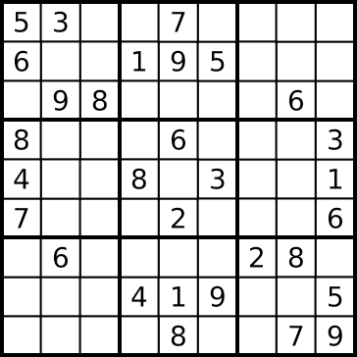
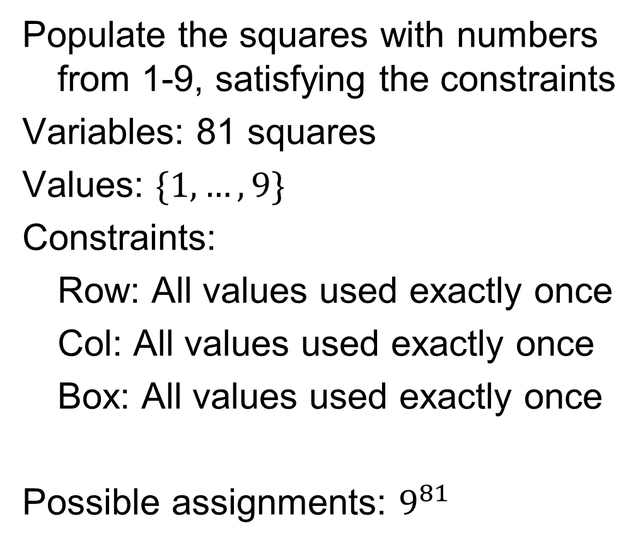
Example: Sudoku
Populate the squares with numbers from 1-9, satisfying the constraints
Variables: 81 squares
Values: $\{1,…,9\}$
Constraints:
Row: All values used exactly once
Col: All values used exactly once
Box: All values used exactly once
Possible assignments: $9^{81}$

Slide 15


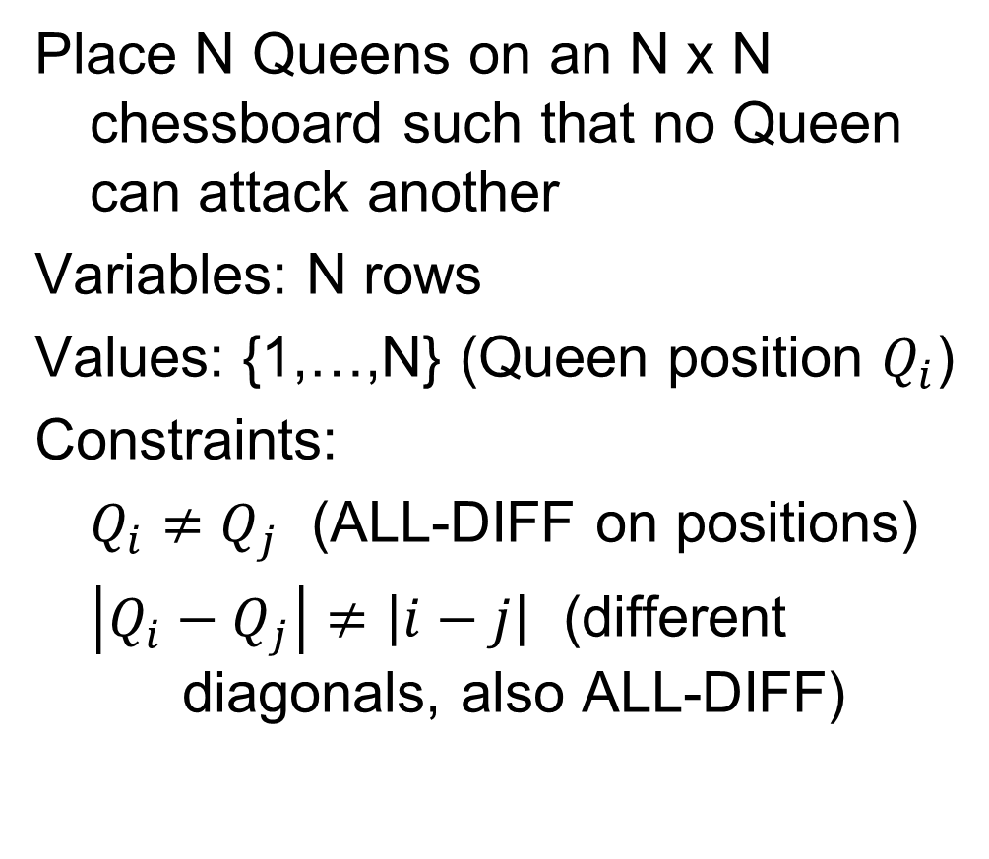



Example: N-Queens
Place N Queens on an N x N chessboard such that no Queen can attack another
Variables: N rows
Values: {1,…,N} (Queen position $Q_{i}$)
Constraints:
$Q_{i}≠Q_{j}$ (ALL-DIFF on positions)
$\left|Q_{i}−Q_{j}\right|≠\left|i−j\right|$ (different diagonals, also ALL-DIFF)
$$Q_{1}=3$$
$$Q_{2}=1$$
$$Q_{3}=4$$
$$Q_{4}=2$$
Solution to 4 Queens

Slide 16
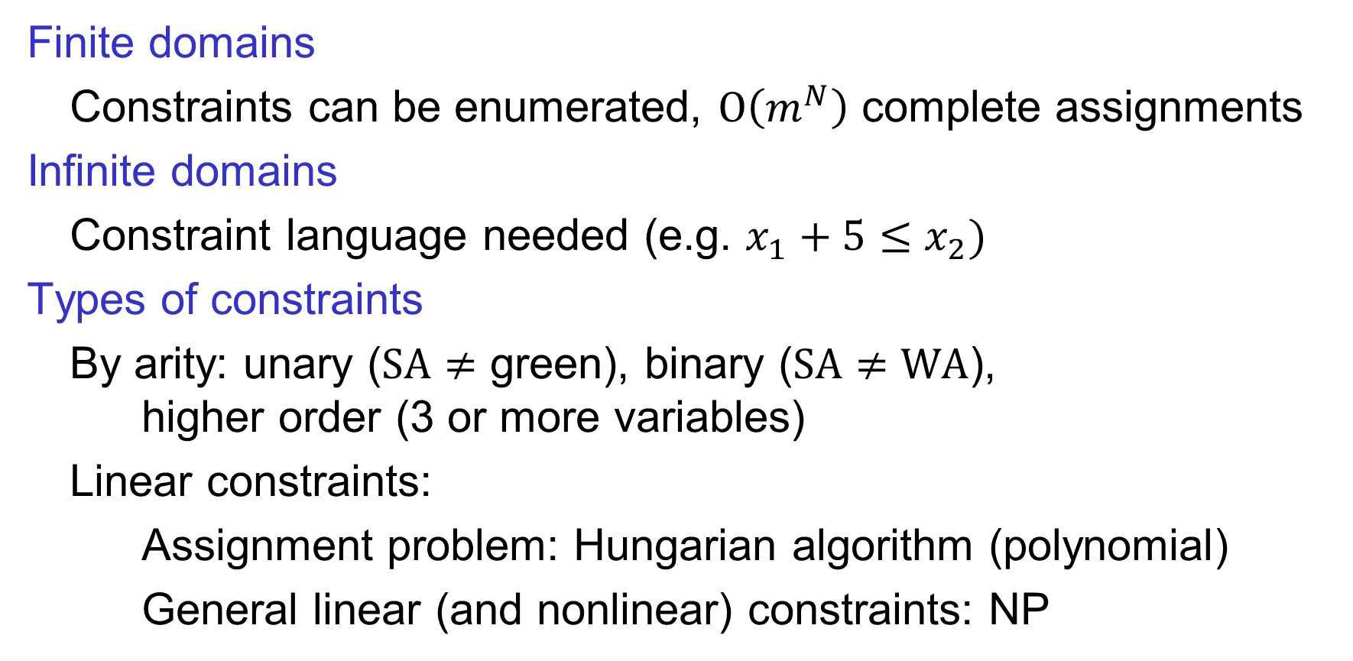
Constraint Satisfaction Problems in Discrete Variables
Finite domains
Constraints can be enumerated, $O\left(m^{N}\right)$ complete assignments
Infinite domains
Constraint language needed (e.g. $x_{1}+5≤x_{2})$
Types of constraints
By arity: unary ($SA≠$ green), binary ($SA≠WA$), higher order (3 or more variables)
Linear constraints:
Assignment problem: Hungarian algorithm (polynomial)
General linear (and nonlinear) constraints: NP
Notes:
How does the complexity of CSP problems vary with their definition? Problems with discrete variables are harder in general than problems with continuous variables, because in addition to whatever constraints are used, there is the additional constraint that the solutions be integers. The class of general discrete CSP includes problems like satisfiability (SAT) which played an important role in developing the theory of NP Completeness. Problems with general linear constraints over integer variables, known as Integer Linear Programming (ILP), are also in NP. The assignment problem is a special case which can be solved in polynomial time using the Hungarian algorithm. There is an interesting interplay between AI methods for solving CSPs, such as arc consistency, and techniques from the combinatorial optimization literature.

Slide 17
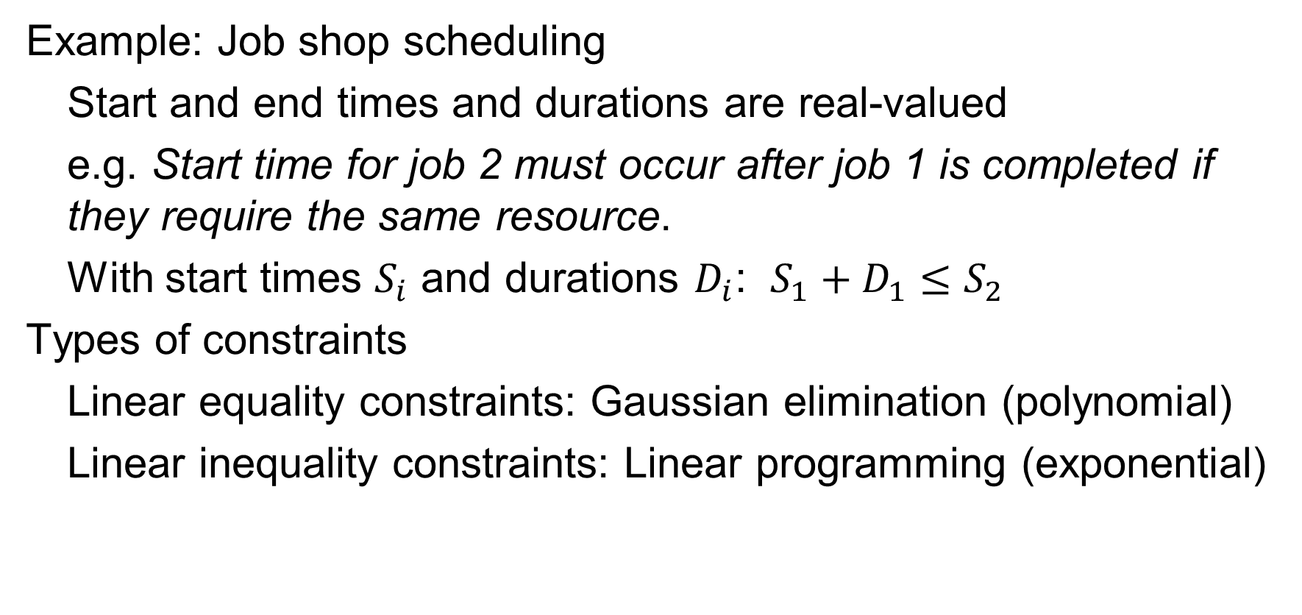
CSPs in Continuous Variables
Example: Job shop scheduling
Start and end times and durations are real-valued
e.g. Start time for job 2 must occur after job 1 is completed if they require the same resource.
With start times $S_{i}$ and durations $D_{i}$: $S_{1}+D_{1}≤S_{2}$
Types of constraints
Linear equality constraints: Gaussian elimination (polynomial)
Linear inequality constraints: Linear programming (exponential)
Notes:
Problems with continuous variables will not considered in detail in this class. They can be roughly organized by the types of constraints. For systems of linear equations, the Gaussian elimination method runs in polynomial time. When inequality constraints are included, then linear programming (e.g. simplex method) can be used. It is exponential in the worst case but polynomial in the “average case.”

Slide 18
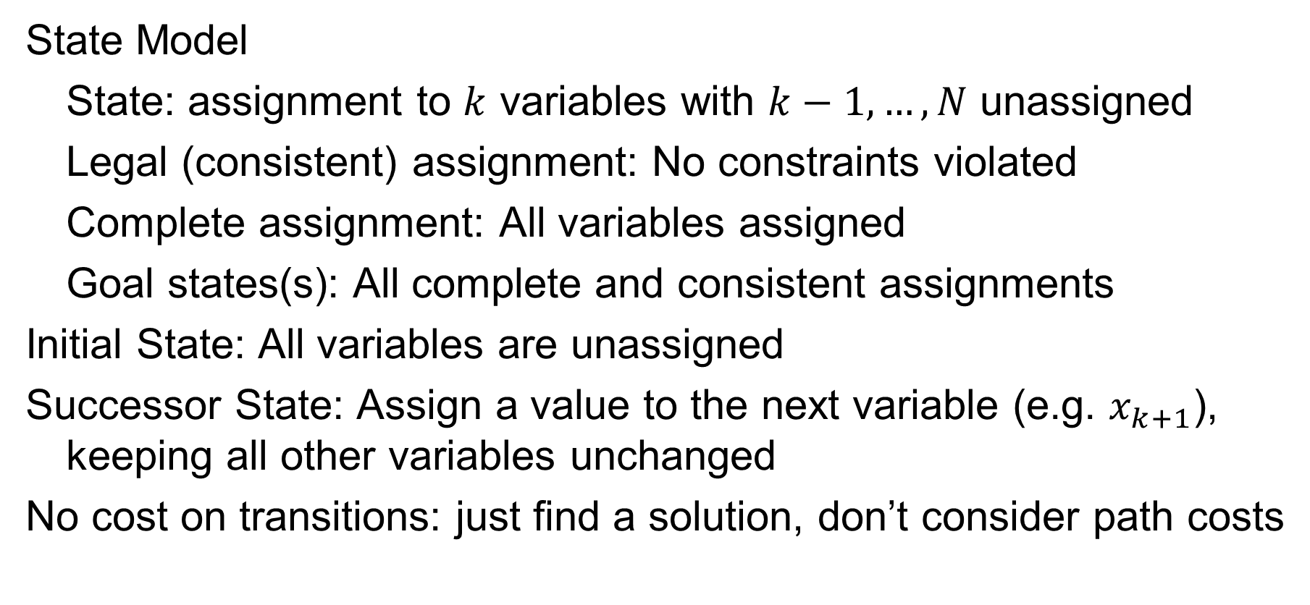
Solving CSPs via Search
State Model
State: assignment to $k$ variables with $k−1,…,N$ unassigned
Legal (consistent) assignment: No constraints violated
Complete assignment: All variables assigned
Goal states(s): All complete and consistent assignments
Initial State: All variables are unassigned
Successor State: Assign a value to the next variable (e.g. $x_{k+1}$), keeping all other variables unchanged
No cost on transitions: just find a solution, don’t consider path costs

Slide 19
Backtracking Search
Expand WA
Notes:
Note that the order of assignments doesn’t matter. For example, assigning WA = red and then NT = blue is the same as assigning NT = blue and WA = red. This is because we don’t care about the paths between states, we just care about reaching a goal state. Another way to say this is that the assignments are commutative. This motivates the design of a depth-first search method where each depth of the tree corresponds to picking an unassigned variable and expanding all of its possible assignments. In this example, we first expand WA and generate all of its possible values.

Slide 20
Backtracking Search
Inconsistent
with constraints,
backtrack
Expand WA
Expand NT
WA | NT | NSW | Q | SA | V
Notes:
We proceed depth-first, expanding nodes in the tree. After generating successors, it makes sense to check immediately if any successors violate the constraints. In this case the assignment (WA = red, NT = red) is inconsistent, so we prune that branch immediately and backtrack to the next leaf for further expansion.

Slide 21
Backtracking Search
WA | NT | NSW | Q | SA | V

Slide 22
Backtracking Search
WA | NT | NSW | Q | SA | V
WA | NT | NSW | Q | SA | V

Slide 23
Backtracking Search
If no consistent
assignment at current depth, then backtrack to previous depth
WA | NT | NSW | Q | SA | V
WA | NT | NSW | Q | SA | V
No legal assignments for SA → Backtrack!

Slide 24
4 Queens Example
Figure credit: Hajjat Ghaderi, U. Toronto
Notes:
The first two value assignments for row 2 violate column and diagonal constraints, respectively. The 3rd is consistent, but at the next level there are no consistent assignments for row 3, so backtrack.

Slide 25
4 Queens Example
Figure credit: Hajjat Ghaderi, U. Toronto
Notes:
The only legal assignment in row 3 leads to failure at row 4, must backtrack all the way to row 1. It is the queen in the top left corner which is problematic.

Slide 26
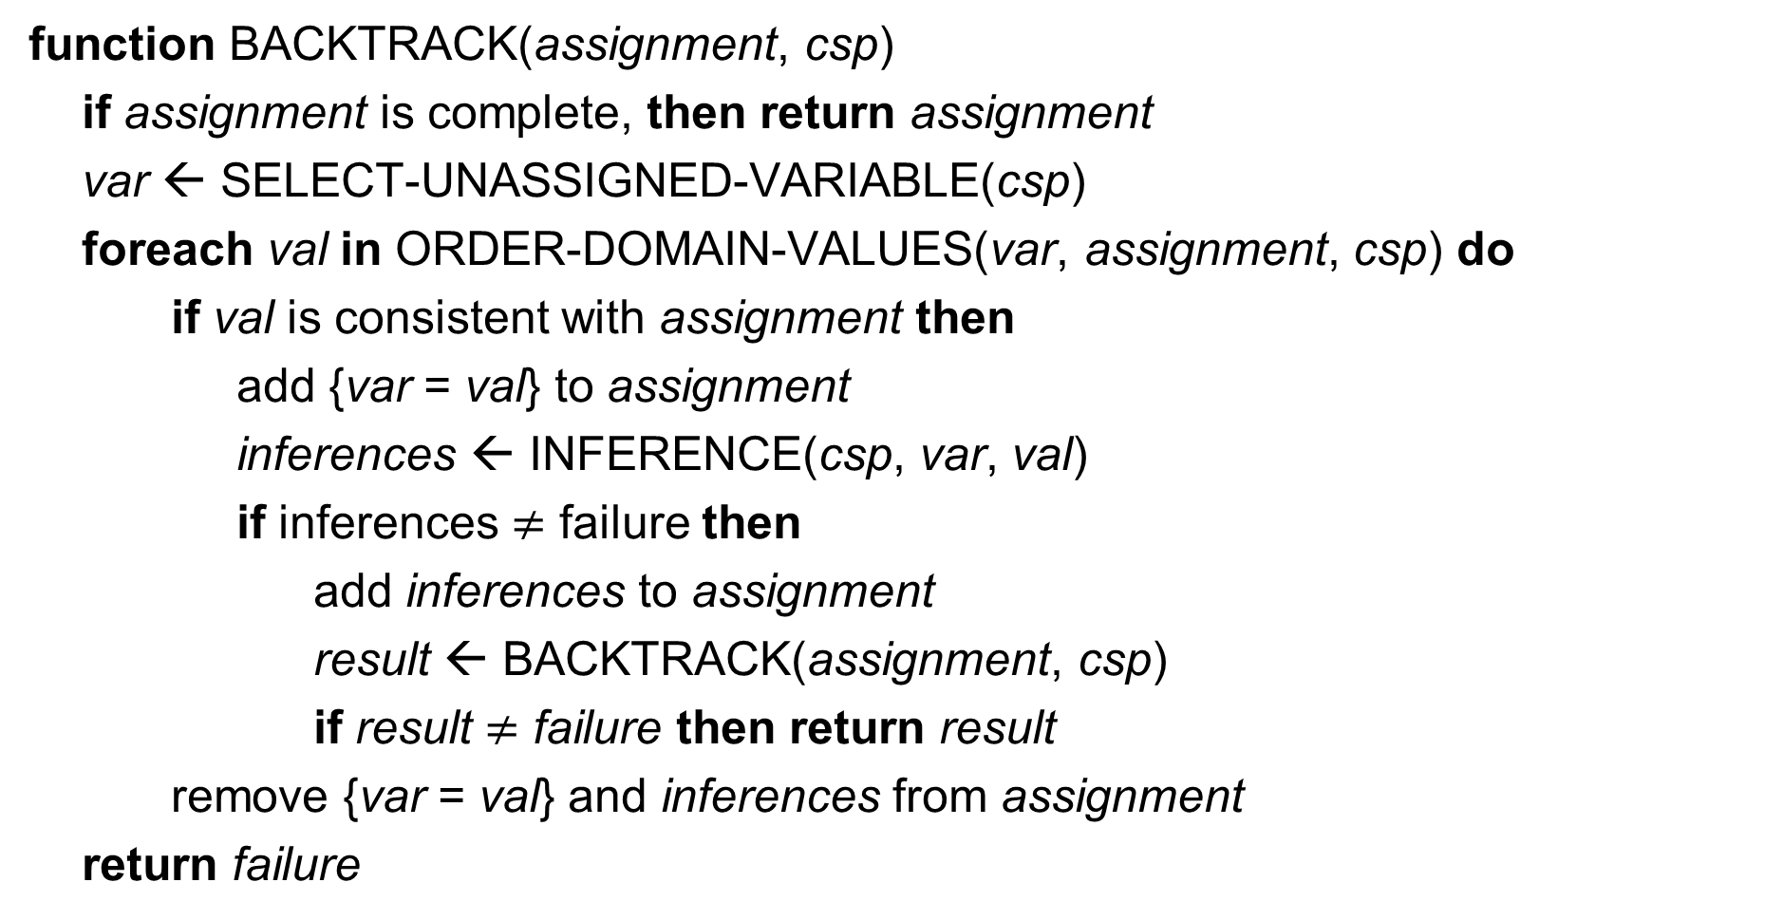
Pseudocode for Backtracking Search
function BACKTRACK(assignment, csp)
if assignment is complete, then return assignment
var ← SELECT-UNASSIGNED-VARIABLE(csp)
foreach val in ORDER-DOMAIN-VALUES(var, assignment, csp) do
if val is consistent with assignment then
add {var = val} to assignment
inferences ← INFERENCE(csp, var, val)
if inferences $≠$ failure then
add inferences to assignment
result ← BACKTRACK(assignment, csp)
if result $≠$ failure then return result
remove {var = val} and inferences from assignment
return failure

Slide 27
Pseudocode for Backtracking Search
function BACKTRACK(assignment, csp)
if assignment is complete, then return assignment
var ← SELECT-UNASSIGNED-VARIABLE(csp)
foreach val in ORDER-DOMAIN-VALUES(var, assignment, csp) do
if val is consistent with assignment then
add {var = val} to assignment
inferences ← INFERENCE(csp, var, val)
if inferences $≠$ failure then
add inferences to assignment
result ← BACKTRACK(assignment, csp)
if result $≠$ failure then return result
remove {var = val} and inferences from assignment
return failure
Given a valid assignment, add to solution and call BACKTRACK recursively to go deeper
If you can’t go deeper,
remove last value and pop to previous level
of tree to try again

Slide 28
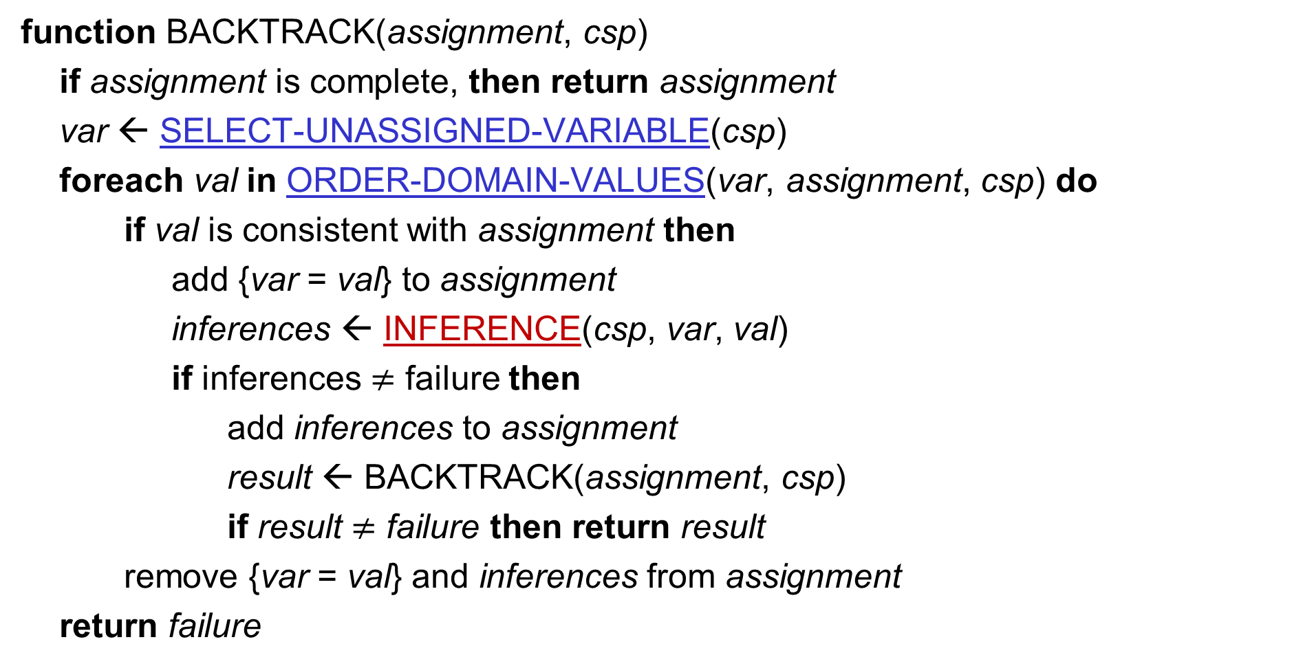
Pseudocode for Backtracking Search
function BACKTRACK(assignment, csp)
if assignment is complete, then return assignment
var ← SELECT-UNASSIGNED-VARIABLE(csp)
foreach val in ORDER-DOMAIN-VALUES(var, assignment, csp) do
if val is consistent with assignment then
add {var = val} to assignment
inferences ← INFERENCE(csp, var, val)
if inferences $≠$ failure then
add inferences to assignment
result ← BACKTRACK(assignment, csp)
if result $≠$ failure then return result
remove {var = val} and inferences from assignment
return failure
Use heuristics to select
variables and values to expand first
Use inference to check
outcome of assignments,
reducing search space

Slide 29
Ways to Improve Backtracking Search
What variable to assign next?
What order to use for values of a variable?
What inferences can be made from an assignment?
How can we take advantage of problem structure?

Slide 30
Ways to Improve Backtracking Search
What variable to assign next?
Choose variable with fewest values left → fail first
What order to use for values of a variable?
What inferences can be made from an assignment?
How can we take advantage of problem structure?

Slide 31
Minimum Remaining Values (MRV)
Choose the variable with the fewest remaining legal values
NT
Q
WA
SA
NSW
V

Slide 32
Minimum Remaining Values (MRV)
Choose the variable with the fewest remaining legal values
NT and SA both valid choices
Both constrained by WA = red
NT
Q
WA
SA
NSW
V

Slide 33
Minimum Remaining Values (MRV)
Choose the variable with the fewest remaining legal values
NT
Q
WA
SA
NSW
V

Slide 34
Minimum Remaining Values (MRV)
Choose the variable with the fewest remaining legal values
?
What should we do when all variables are equal under MRV?

Slide 35
Degree Heuristic: Tie Breaker for MRV
Choose the variable which participates in largest number of
constraints on unassigned variables (highest degree)
SA has degree 5
NT and NSW equal with degree 2
WA and Q have 1 MRV, Q has degree 1, while WA has 0
NT
Q
WA
SA
NSW
V
Notes:
In this example, the combination of MRV and the degree heuristic solves the problem without any false steps, and choosing any consistent color at each point results in a solution with no backtracking.

Slide 36
Ways to Improve Backtracking Search
What variable to assign next?
Choose variable with fewest values left → fail first
What order to use for values of a variable?
Choose val that leaves most options for remaining vars → fail last
What inferences can be made from an assignment?
How can we take advantage of problem structure?

Slide 37
Least Constraining Value
Choose the value which removes the least number of potential values from the remaining unassigned variables
Choosing Q=red leaves
1 value for SA,
while Q=blue would leave
0 values
NT
Q
WA
SA
NSW
V
Notes:
Once we have expanded to a particular variable at a given depth, we would like to go deeper to see if we can find a solution along the path we are on, since we only care about getting to a single solution quickly. The choice of Least Constraining Value keeps the search alive by giving future variables the most options. In contrast, in choosing variables to expand, we can reduce the branching factor of the tree by pruning branches early, and thus we use MRV for variable selection.

Slide 38
Summary
Constraint Satisfaction Problems encode explicit problem structure in a simple representation language (variables + values + const)
Backtracking search is a specialized version of DFS that exploits the structure of CSPs
Unlike classical search, there is no path cost. The only thing that matters is reaching a consistent and complete solution quickly
The Minimum Remaining Values heuristic for variable selection can decrease the search space, use the degree heuristic for ties
The Least Constraining Value heuristic for value ordering can reduce the amount of backtracking

Slide 39
Questions?

